Slide 1
How to Communicate Ideas
10
A Great Guide by Richard Borden in 1935
• Good for All Speaking and Writing
Based on the reprint of the same title
(Fairfield, NJ: The Economics Press, 1935)
Dr. Rick Griffith • Jordan Evangelical Theological Seminary • BibleStudyDownloads.org

Slide 2

Many speakers are boring…

Slide 3

How can we speak so people will listen?

Slide 4
Four Objectives:
A Sermon That is…
25
True
Interesting
Clear
Relevant

Slide 5
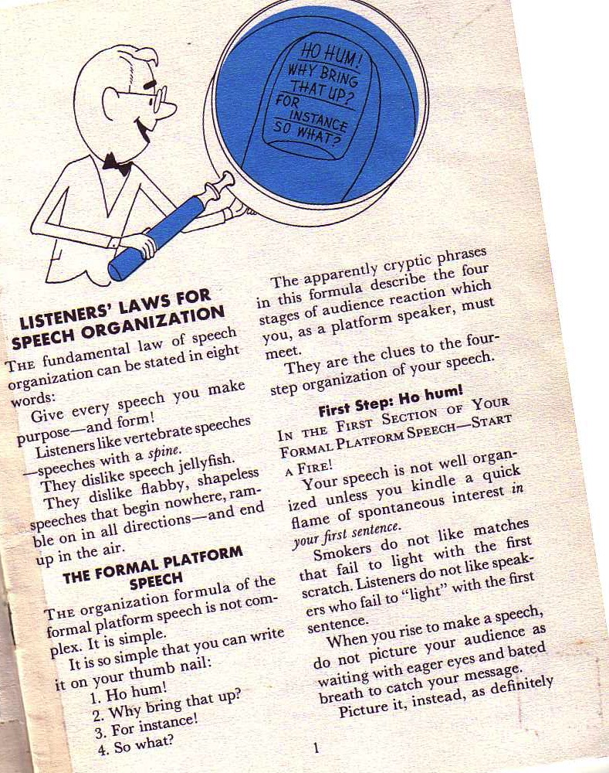
Borden's Basics
10-11
The fundamental law of speech organization can be stated in eight words:
Give every speech you make purpose––and form!
Richard Borden, How to Communicate Ideas, 1
Notes:
Same slide for presentation 01.30 and 03.05 so translators may copy from one to the other

Slide 6
Organization of a
Formal Platform Speech
11a
 | Audience Reaction | Speaker’s Solution | Homiletical Parallel
1 | Ho hum! | Start a fire | Capture attention or interest
2 | Why bring that up? | Build a bridge | Raise need
3 | For instance! | Get down to cases | Illustrations
4 | So what? | Ask for action | Application
Adapted from Richard Borden, How to Communicate Ideas, 1

Slide 7
Borden's Steps:
A Speech Answering…
11a
True:
Substance
Laws
Interesting:
Ho hum!
For Instance!
Clear:
Phraseology Laws
Relevant:
Why bring that up?
So what?
Adapted from Richard Borden, How to Communicate Ideas, 1

Slide 8

What should you say?
(Content)

Slide 9
Listener Laws for Substance
11a
Listeners like speech content
“for instances”…
In story form
That involve famous people
That animate the pages of history
Based on colorful analogies
That dramatize important statistics
Interwoven with visual aids
Richard Borden, How to Communicate Ideas, 10-14

Slide 10
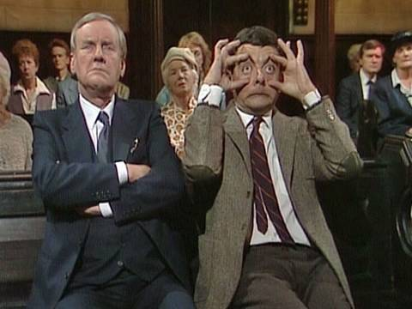
How should you say it?
(Delivery)

Slide 11
Listener Laws for Phraseology
11a
The words of your speech should be…
Free from wax (avoid unnecessary words)
Grammatically surefooted (good grammar in short sentences)
Conversational
Specific
Picturesque
Clear
Richard Borden, How to Communicate Ideas, 15-20

Slide 12
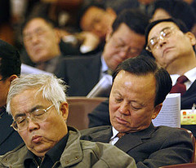
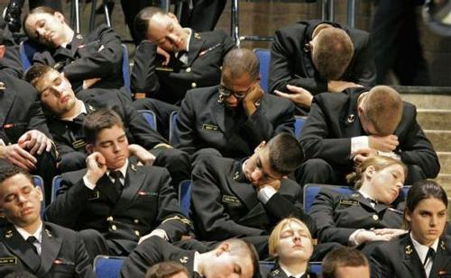
Sleepers

Slide 13

Black
Notes:
Kahoot.com is a great way to keep an interest in teaching and preaching. It helps you see immediately the audience's opinion on an issue as they type their response into their phones.

Slide 14
Black

Slide 15


Preaching (Homiletics) link at BibleStudyDownloads.org
Get this presentation for free!
Notes:
Preaching (pr)
Homiletics

